Slide 1
Lab Drawings & Cell Movement
Amoeba sp., Euglena sp., Paramecium sp., & Volvox sp.

Slide 2
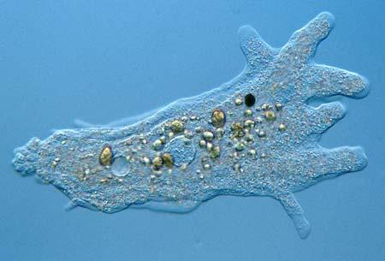
Amoeba sp

Slide 3
Amoeba Terms
Cell membrane
Contractile vacuole
Cyst
Ectoplasm
Endoplasm
Food vacuole
Nucleus
Pseudopodia

Slide 4
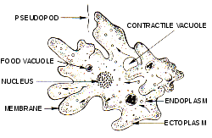
Amoeba sp

Slide 5
Cytoplasmic Streaming
Eating
Cytoplasmic Streaming
Amoeba eating two paramecium

Slide 6
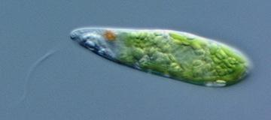
Euglena sp

Slide 7
Euglena Terms
Chloroplast
Contractile vacuole
Eyespot
Flagellum
Nucleus
Nucleolus
Pellicle

Slide 8
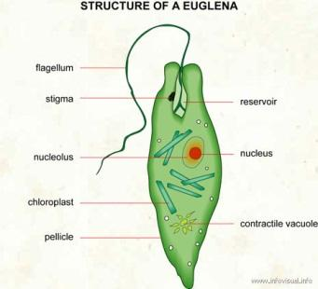
Euglena sp

Slide 9
Flagella
Whip-like flagella

Slide 10
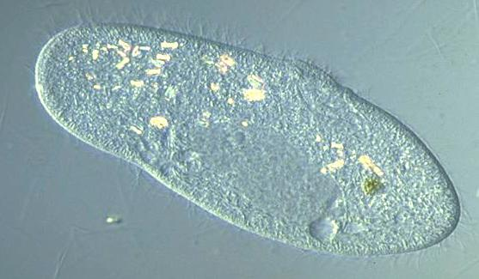
Paramecium sp

Slide 11
Paramecium Terms
Cilia
Contractile vacuole
Cytoplasm
Food vacuole
Nucleus
Pellicle

Slide 12
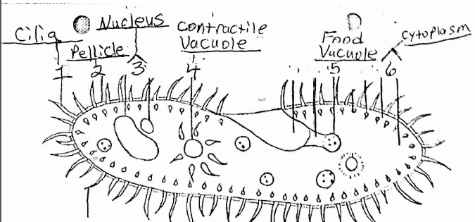
Paramecium sp

Slide 13
Cilia
Metachromal waves of cilia

Slide 14
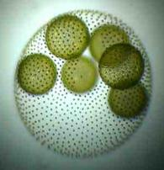
Volvox sp

Slide 15
Volvox Terms
Cilia
Contractile vacuole
Cytoplasm
Food vacuole
Nucleus
Pellicle

Slide 16
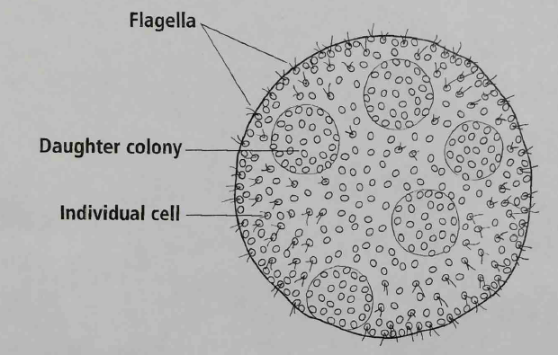
Volvox sp

Slide 17
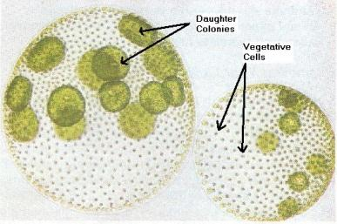
Volvox sp

Slide 18
Flagella - movement in a colony
Flagella movement in a colony

Slide 19
Questions
Describe to Mary, a peer who was absent,:
how cytoplasmic streaming works?
how flagella moves?
how cilia moves?
how flagella moves in a colony?

Slide 20
How are these harmful?
Monsters inside me - brain amoeba

