Slide 1
Making the 17-1 Motion Foldable

Slide 2
Fold the paper in half
Draw a line down the middle in the fold

Slide 3
Fold the left side to the middle and make a crease.
Fold the right side to the middle and make a crease.

Slide 4
Draw a line down the crease of each side.

Slide 5
You are to line the zero cm line on the ruler to the edge of the paper.
Make a mark every 6 cm.
Make a mark at 6, 12, 18, and 24.
Move the ruler to the other end and repeat.

Slide 6
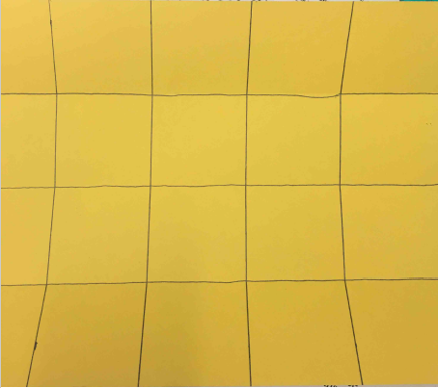
Line up the 6 cm mark and draw a line.
Line up the 12 cm mark and draw a line.
Line up the 18 cm mark and draw a line.
Line up the 24 cm mark and draw a line.

Slide 7
Turn the paper landscape.
Fold the bottom flap up.
Continue the line.
Repeat 3 more times.
Turn the paper around.
Fold the other flap up.
Continue the line.
Repeats 3 more times.

Slide 8
Fold the flaps down and on the outside draw a line and write the heading.
In the rest of the top box, write the two titles:
Reference Point
Velocity

Slide 9
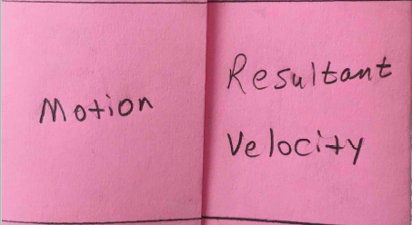
With the flaps folded down, on the second pair of boxes write:
Motion
Resultant Velocity

Slide 10
With the flaps folded down, on the third pair of boxes write:
Speed
Acceleration and Deceleration
(Positive and Negative)

Slide 11
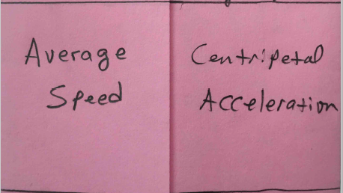
With the flaps folded down, on the fourth pair of boxes write:
Average Speed
Centripetal Acceleration

Slide 12
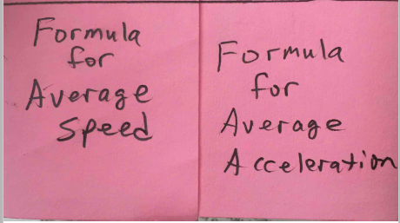
With the flaps folded down, on the last pair of boxes write:
Formula for Average Speed
Formula for Average Acceleration

Slide 13
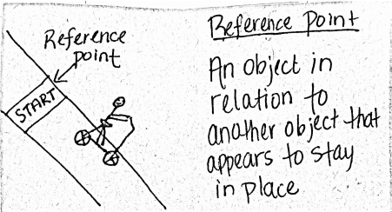
With the flaps open, on the top left pair of boxes write:

Slide 14
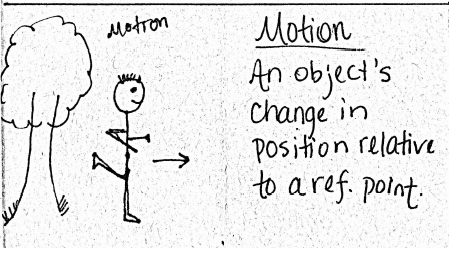
With the flaps open, on the second from the top left pair of boxes write:

Slide 15
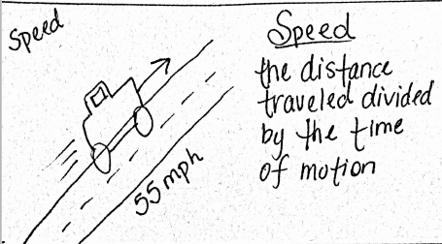
With the flaps open, on the third from the top left pair of boxes write:

Slide 16
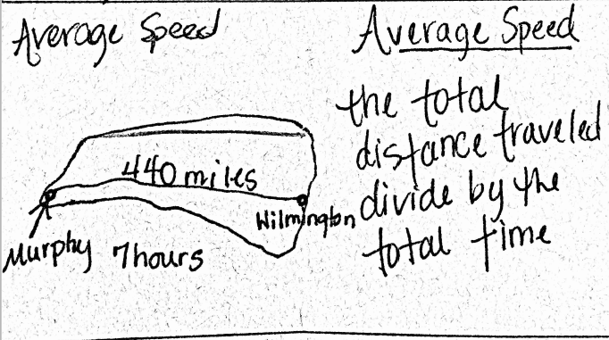
With the flaps open, on the fourth from the top left pair of boxes write:

Slide 17
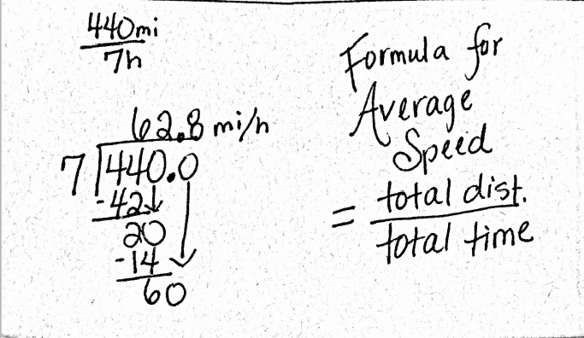
With the flaps open, on the bottom left pair of boxes write:

Slide 18
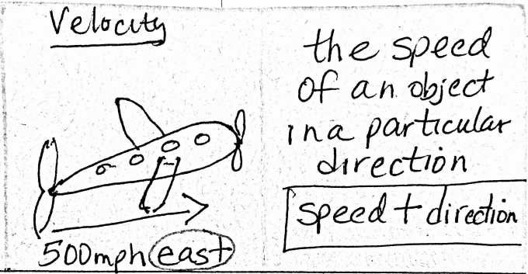
With the flaps open, on the top right pair of boxes write:

Slide 19
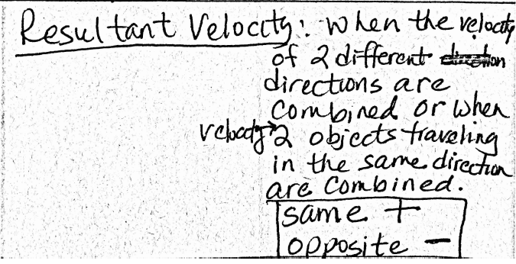
With the flaps open, on the second from the top right pair of boxes write:

Slide 20
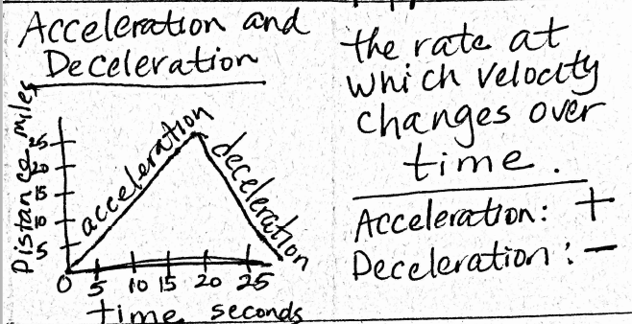
With the flaps open, on the third from the top right pair of boxes write:

Slide 21
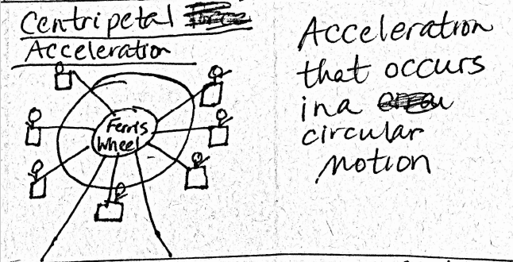
With the flaps open, on the fourth from the top right pair of boxes write:

Slide 22
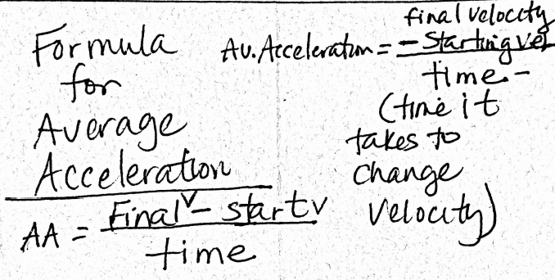
With the flaps open, on the bottom right pair of boxes write:

Slide 23
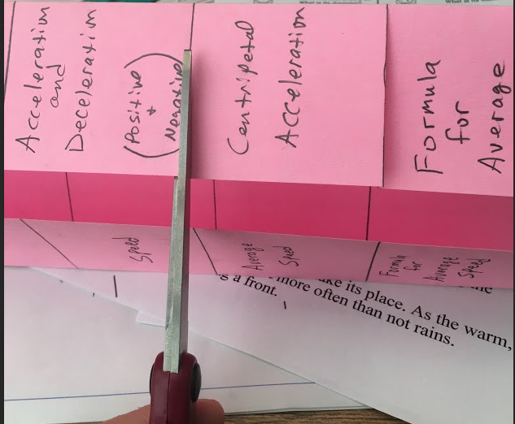
Cut the flaps apart by cutting on the lines.

